Slide 1
Graph theory overview.
Our name

Slide 2
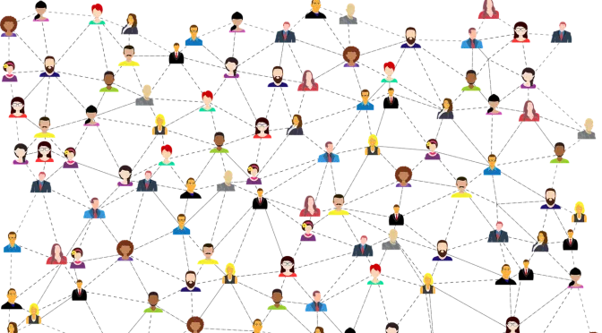
Getting start with graph theory what is it?
Notes:
In mathematics, graph theory is the study of graphs, which are mathematical structures used to model pairwise relations between objects. A graph in this context is made up of vertices (also called nodes or points) which are connected by edges(also called links or lines). The definition of it could be complex that’s why let’s explain it with example of networks.
One of the examples about social networks of friends , visualizing data onto graphs allows us to generate and answer different interesting questions about the data. In the case of a social network, we could ask questions like how many friends does John have or how many mutual friends are there between Aybek and Rimma.
Graphs are used to represent many real-life applications: Graphs are used to represent networks. The networks may include paths in a city or telephone network or circuit network. Graphs are also used in social networks like linkedIn, Facebook. For example, in Facebook, each person is represented with a vertex(or node). Each node is a structure and contains information like person id, name, gender, and locale.Following is an example of an undirected graph with 5 vertices.

Slide 3
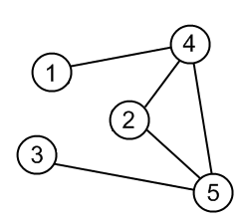
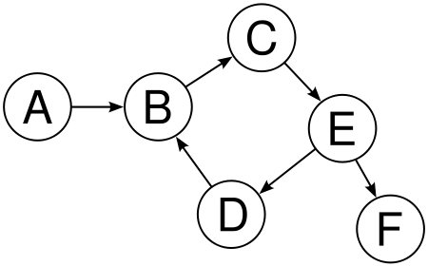
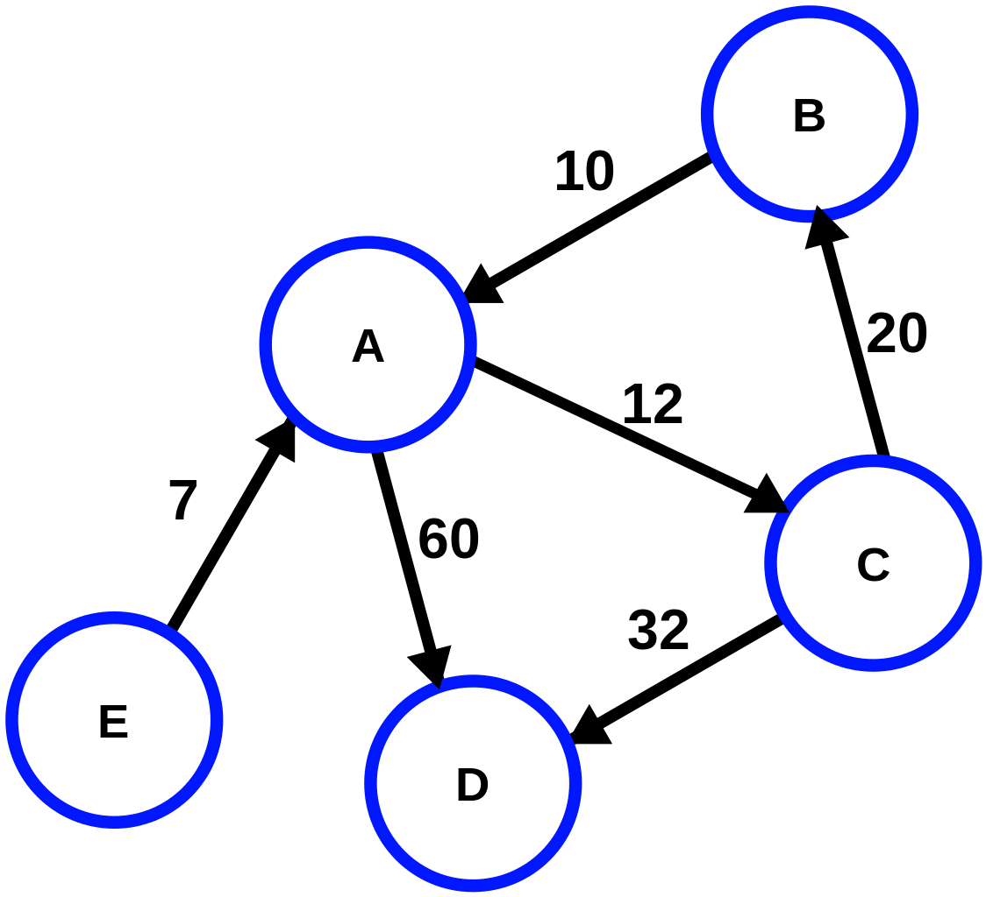
Types of graph
1)
2)
3)
Notes:
There are different types of graph, we have to know what kind of graph we work and solve problems.
2) As the name shows, there won’t be any specified directions between nodes. So an edge from node A to B would be identical to the edge from B to A. In graph, each node could represent different places and the edges show the bidirectional roads.
1) But undirected graphs, directed graphs have orientation or direction among different nodes. That means if you have an edge from node A to B, you can move only from A to B. Like the example of undirected graph, if we consider nodes as cities, we have a direction from place 1 to 2. That means, you can go from place 1 to 2 but not back to city 1, because there is no direction back to place 1 from 2. But if we closely examine the graph, we can see cities with bi-direction. For example cities 3 and 4 have directions to both sides.
3) Third one is Weighted Graphs. Many graphs can have edges contain a weight associated to represent a real world implication such as cost, distance and such kind of like this. Weighted graphs can be directed or undirected graph. The one we have in this example is an directed weighted graph. The cost or distance from nodes from A to C and vice versa is 12. We could represent this relationship as a triplet like (u, v, w) which shows from where the edge is coming in, where it goes and cost or distance between the two nodes.

Slide 4
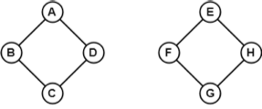




Types of graph
1)
2)
3)
4)
5)
Notes:
Instead of previous types there are another types like Disconnected graph(1), Acyclic graph(5), Cyclic graph(2),Regular graph(3), Star graph(4).

Slide 5
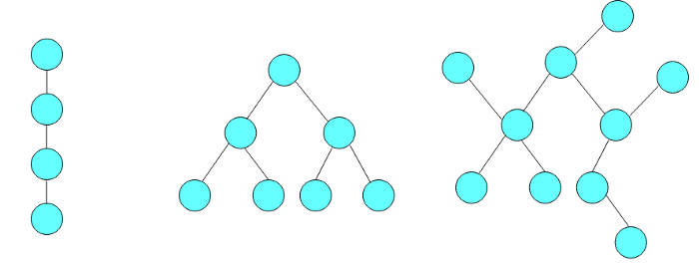
Special types of graph
Notes:
Instead of other divisions there are special types, like Tree, Rooted Tree , and etc.
In this picture we represent most famous graph is Tree. It is undirected graph with no cycle and it has N nodes and N — 1 edges.

Slide 6
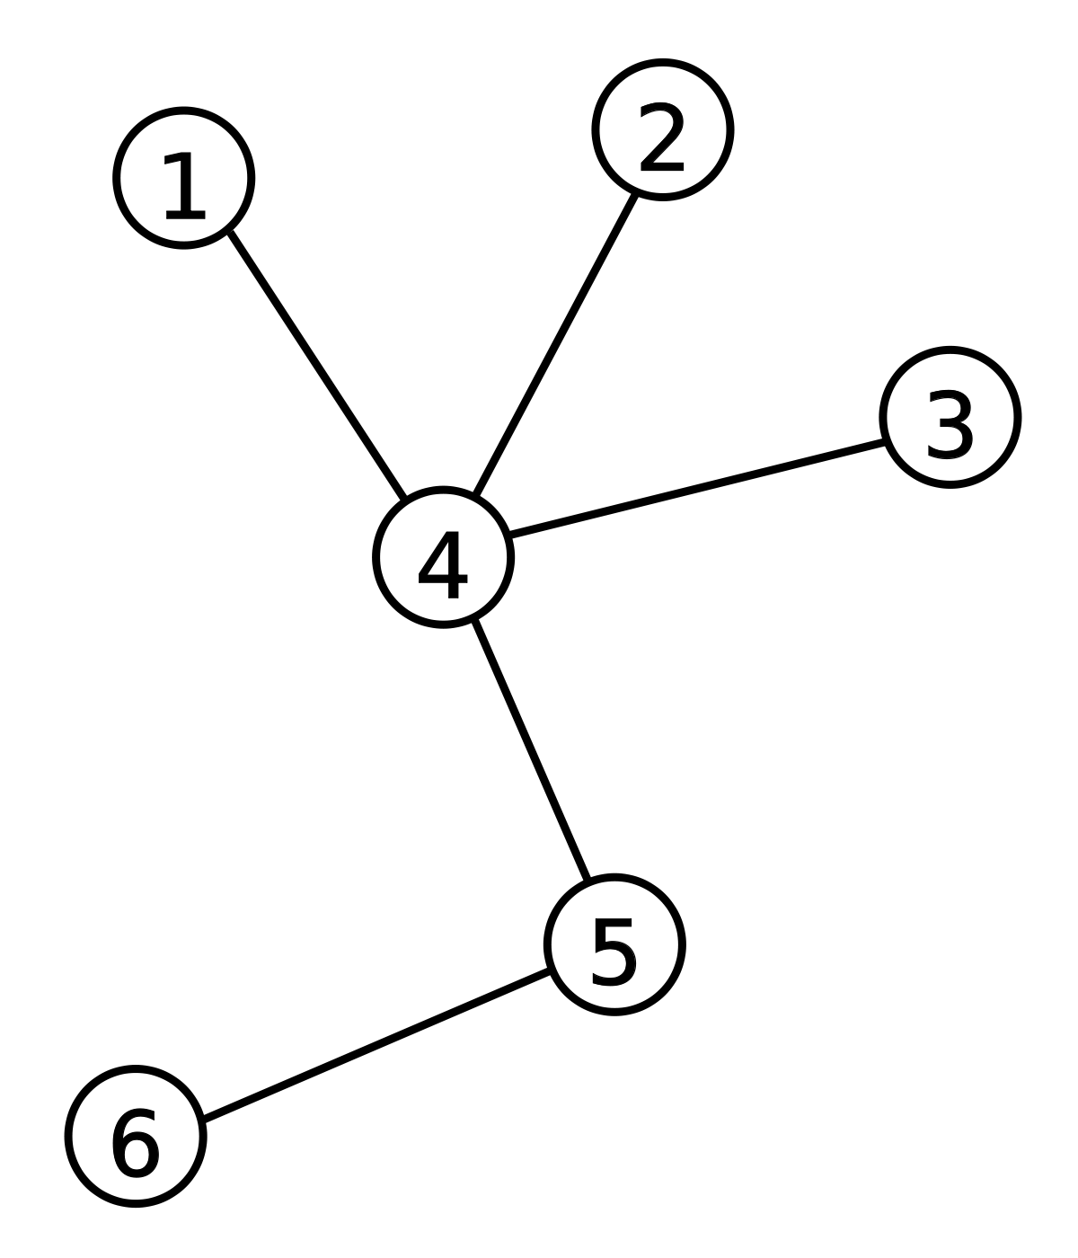
Special types of graph
Notes:
Int this example, A rooted tree is a tree with a designated root node where all other nodes are either coming towards the root or going away from the root. There are types of rooted tree like out-tree, and in-tree , In-tree all nodes are coming towards the root node, and out-tree is nodes goes away from the root.

Slide 7
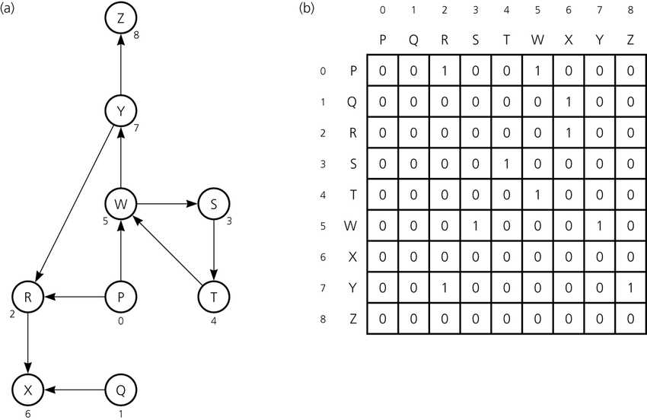
Representation of graph
Notes:
Here we will talk about representation of graph as matrix and store it to memory for further compilation. The efficient way is to use Matrix NxN where N is the number of nodes. This matrix representation is Adjacency matrix. The above represented is of a directed weighted graph and it’s corresponding adjacency matrix M. The matrix is of size 8x8 as there are 8 nodes in total. There are will differences between directed and undericted because we will consider path between one node from second node , as we told undericted has bidirectional roads.

Slide 8
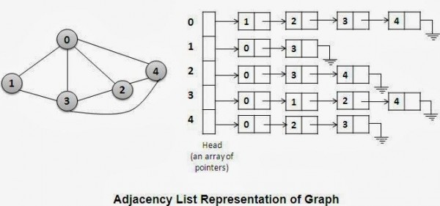
Representation of graph
Notes:
Adjacency List is an efficient mechanism to store the graph information if it is sparse i.e. it would take less memory as compared to the adjacency matrix in the same scenario. But still, this is a slight more complex representation rather than the adjacency matrix.

Slide 9
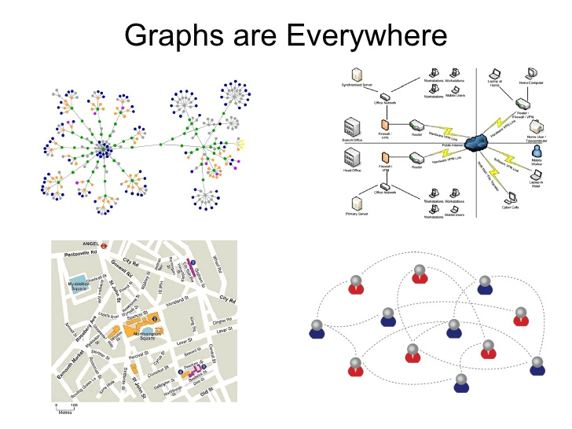
Notes:
With graph we can do next things like,
Dijkstra's Algorithm
Prims's Algorithm
Kruskal's Algorithm Graphs are used to define the flow of computation. Graphs are used to represent networks of communication.
Graphs are used to represent data organization. Graph transformation systems work on rule-based in-memory manipulation of graphs.
Graph databases ensure transaction-safe, persistent storing and querying of graph structured data. Graph theory is used to find shortest path in road or a network.
In Google Maps, various locations are represented as vertices or nodes and the roads are represented as edges and graph theory is used to find the shortest path between two nodes.

